Slide 1

Busify: Online Bus Reservation System
Made By: Linkan Kumar Rout
Meta Scifor Technologies Pvt. Ltd.
ID: MST01-0055
Under Guidance
of Farzana Rashid

Slide 2
Introduction
Welcome to Busify, a comprehensive bus reservation system designed to simplify the process of booking bus tickets online. This project leverages modern web technologies to provide a seamless and user-friendly platform for customers. Built with Django for robust backend functionality and Bootstrap for responsive, visually appealing front-end design, Busify ensures a smooth and efficient booking experience. This project not only streamlines the reservation process but also integrates secure payment gateways like PayPal, ensuring safe and reliable transactions. Join us as we delve into the features, challenges, and future enhancements of Busify, a step forward in digitalizing bus reservations.

Slide 3
Project Objectives
User-Friendly Interface: To provide a straightforward and intuitive interface for users to book bus tickets.
Secure Payments: To ensure secure and seamless payment processing through PayPal.
Efficient Management: To manage bus schedules and seat availability effectively.
Real-Time Notifications: To deliver real-time booking confirmations and notifications to users.

Slide 4

Project Overview
Busify is a comprehensive online bus reservation system designed to facilitate easy and efficient bus ticket booking and schedule management.
The system integrates a secure PayPal payment gateway to ensure seamless online transactions, providing users with a reliable and user-friendly experience.

Slide 5
Key Features
User Registration and Authentication: Secure user login and registration system.
Bus Schedule Management: Admin interface for managing bus schedules and routes.
Real-Time Seat Selection: Interactive seat selection during the booking process.
Secure Payments: PayPal integration for handling online payments securely.
Email Notifications: Automated email notifications for booking confirmations and updates.

Slide 6



Technology Stack
Frontend
Backend
Payment gateway
Utilized HTML, CSS, JavaScript, and Bootstrap for responsive and interactive user interfaces.
Developed using Django, a high-level Python web framework.
Integrated PayPal for secure and efficient online payments.

Slide 7
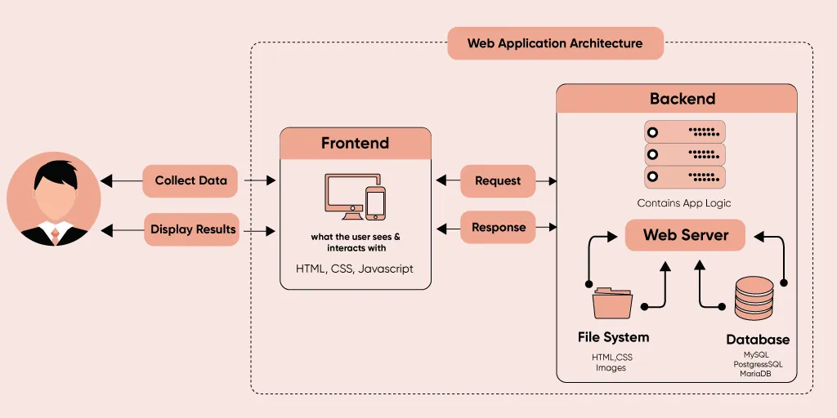
System Architecture
Frontend
Backend
User interfaces created with HTML, CSS, JavaScript, and Bootstrap.
Django handles business logic, user authentication, and interactions with the database.
Database
Payment Gateway
SQLite3 stores all data related to users, bookings, and schedules.
PayPal manages payment processing and ensures secure transactions.

Slide 8
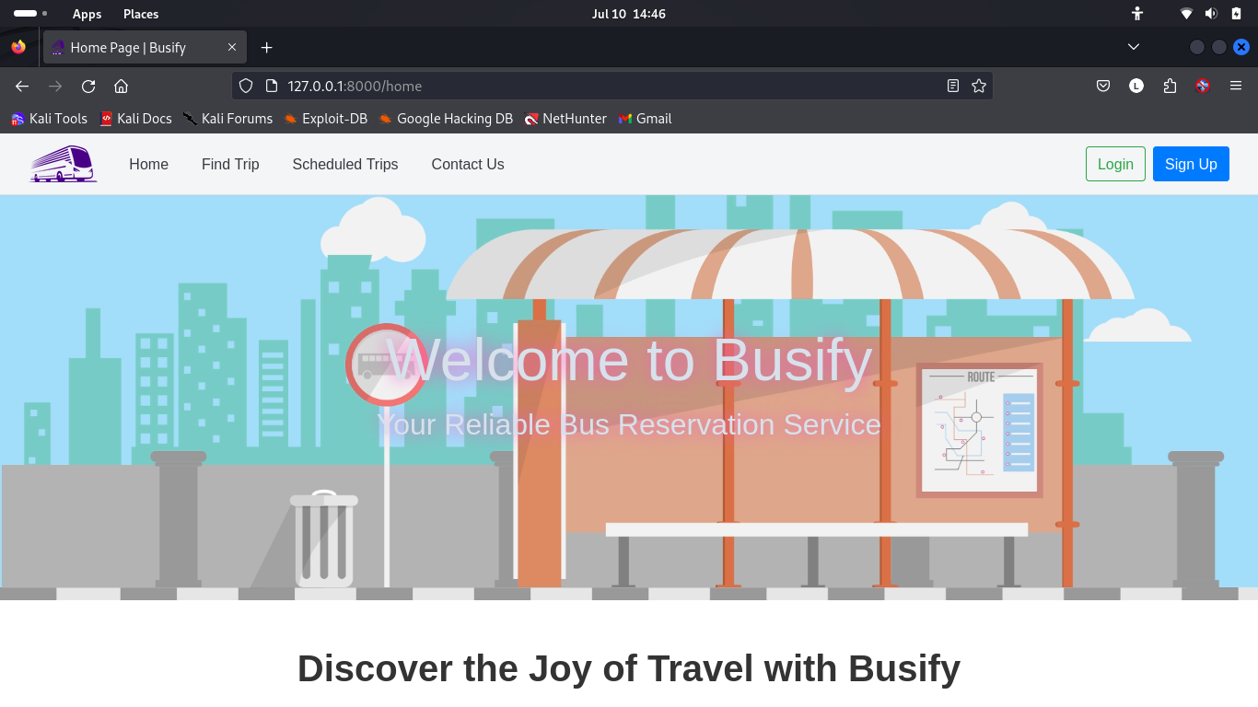
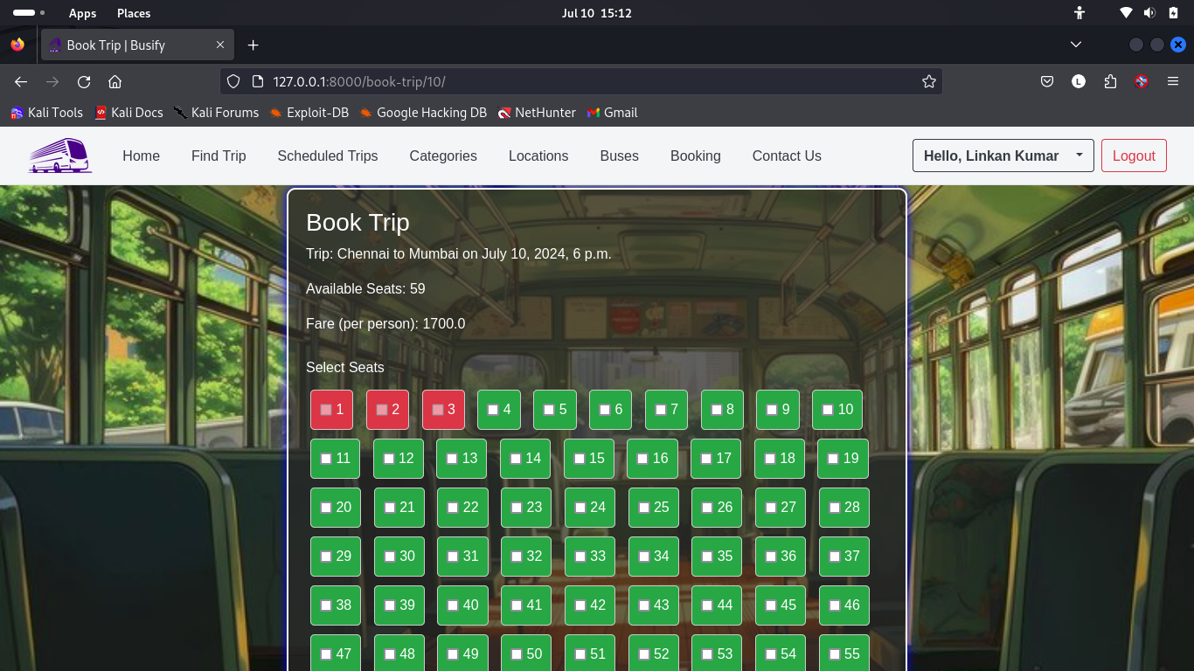
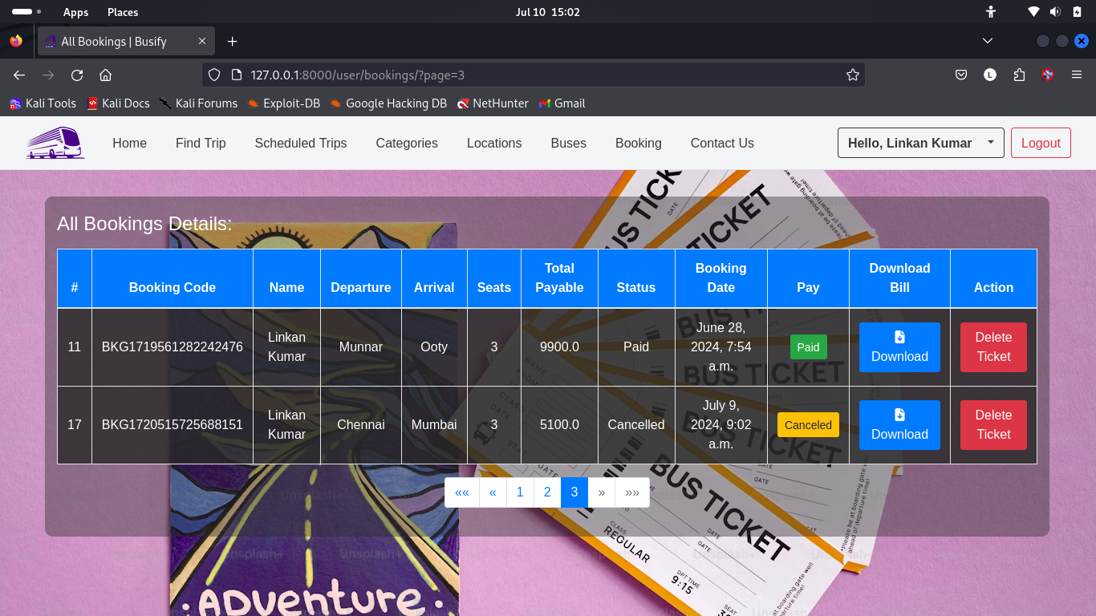
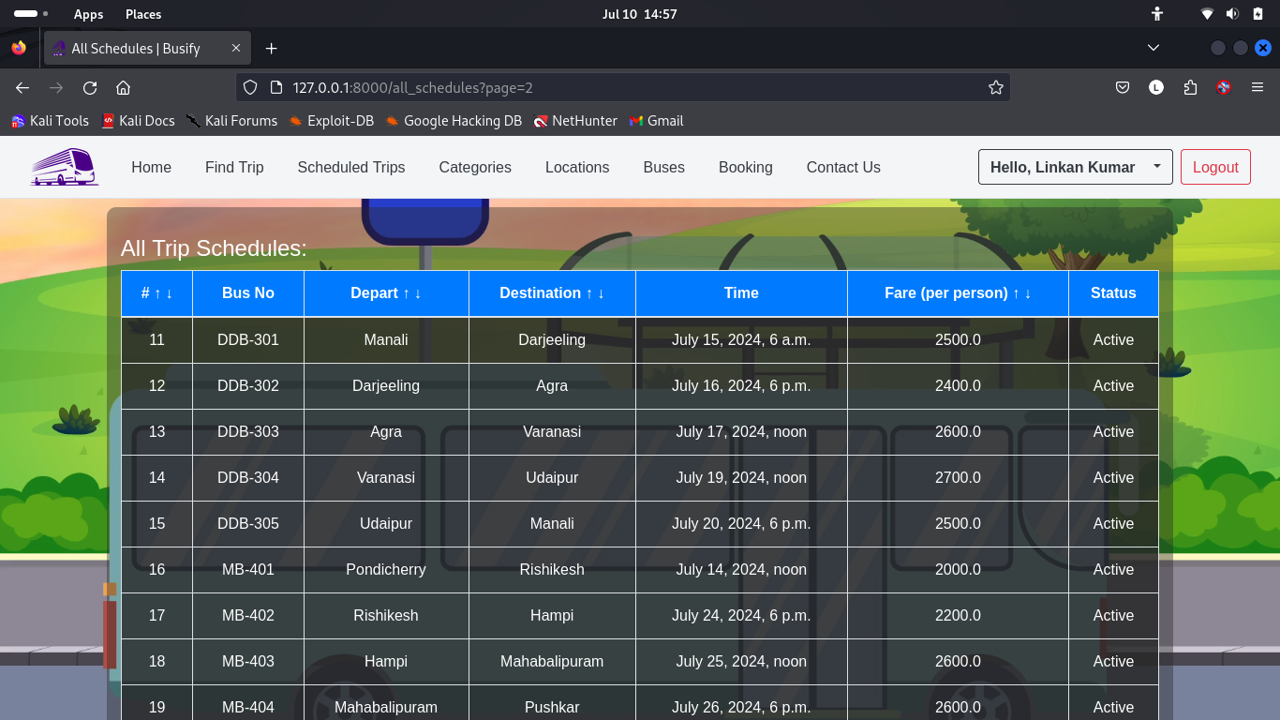
User Interface
Homepage
Seat Booking Page
User Bookings Page
Scheduled Trips Page

Slide 9
Paypal payment
Integration Steps:
Setup PayPal SDK in Django project.
Create payment objects and handle payment redirection.
Process payment confirmation and update booking status.
Security:
All transactions are securely handled by PayPal, ensuring user data is protected.
User Experience:
Smooth transition from booking to payment, with real-time status updates.

Slide 10
Booking Confirmation Process
Real-Time Email Notifications: Upon successful payment, users receive an email with booking details.
Email Content:
Booking code, passenger name, departure and arrival locations, number of seats, total payable amount, and booking date.
Contact information for support and additional details.
User Experience: Ensures users are informed and have a record of their booking.

Slide 11
Challenges and Solutions
Payment Validation Errors: Integrating PayPal's payment gateway presented several validation errors, especially concerning currency format and data consistency. Understanding and implementing the PayPal SDK correctly was initially challenging.
Solution: Extensive debugging and consultation of PayPal's developer documentation were necessary. Implemented comprehensive error handling to provide clear feedback to users in case of payment issues. This ensured a more seamless payment experience.
Real-Time Notifications: Implementing real-time notifications for booking confirmations was essential for user satisfaction but posed challenges in ensuring timely and reliable delivery.
Solution: Implemented an email notification system using Django's email backend. Ensured that emails were sent immediately after successful payment processing, providing users with instant confirmation of their bookings.

Slide 12
2024
Conclusion
- Successfully developed Busify, an online bus reservation system.
Busify
- Provided a secure, user-friendly, and efficient booking process.
- System is scalable and ready for additional features based on user feedback and business requirements.

Slide 13

Thank you

